Slide 1

CRIME DATASET
Data Visualization and Storytelling
MSDA 3060
TEAM MEMBERS
Shree Raksha Sivasubramani
Keerthi Nivasshini Thangaraj

Slide 2

INTRODUCTION
Each entry in the row is marked with location , time and nature of crime committed.
The intensity of the crime and how the nature of each varies with each record.
It also has the police district number which will allow us to analyze.
It also has column Crime committed at morning.

Slide 3
OBJECTIVE
To track crime across the city during various time periods.
Being able to envision and derive conclusions about the causes of crime in the United States.
Inferring criminal behavior and mentalities from crime statistics.
The idea of decoding criminal minds via swarm mentality.

Slide 4
TABLEAU
Which crime has most number of victims.
Which location has the most number of crimes
Which category of crime is most occured
Which year has the most number of crimes committed

Slide 5
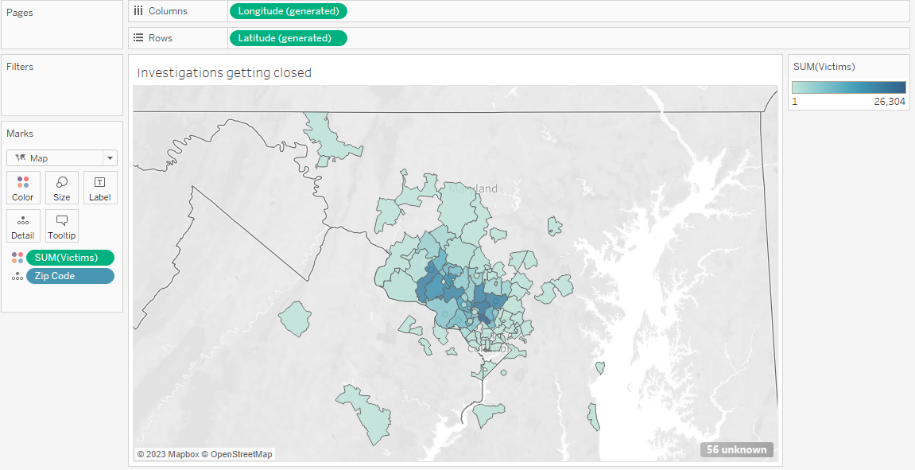
INVESTIGATION VICTIMS HEATMAP

Slide 6
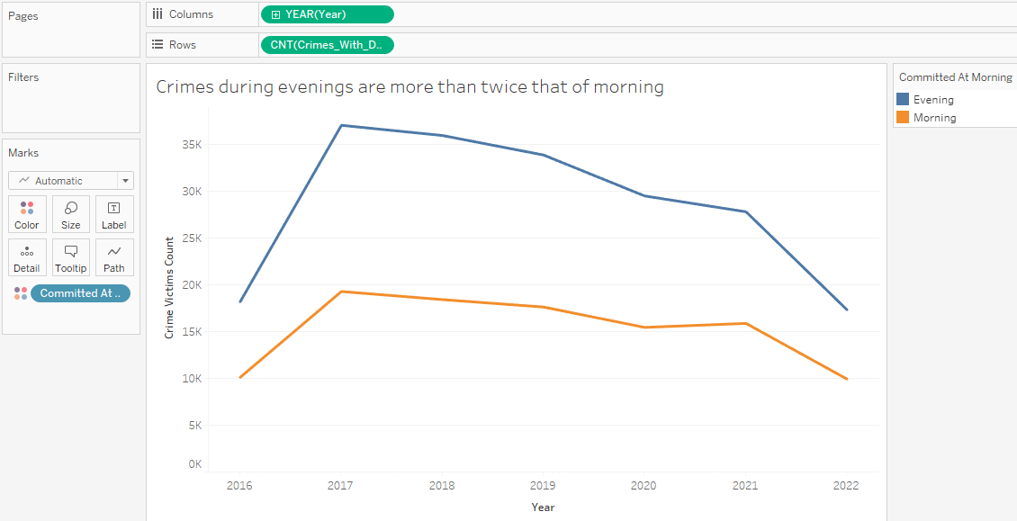
MORNING VS EVENING CRIME RATE

Slide 7
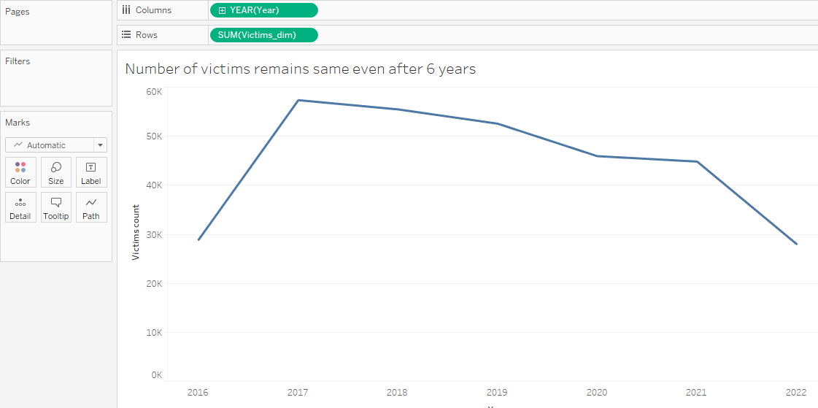
VICTIMS TRENDLINE

Slide 8
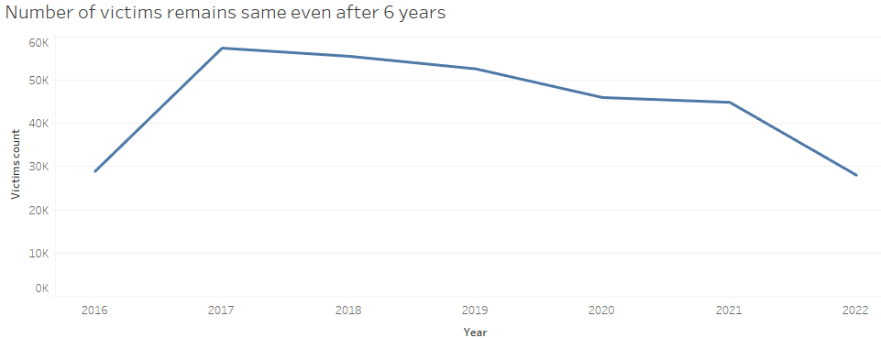
VICTIMS AFTER 6 YEARS

Slide 9
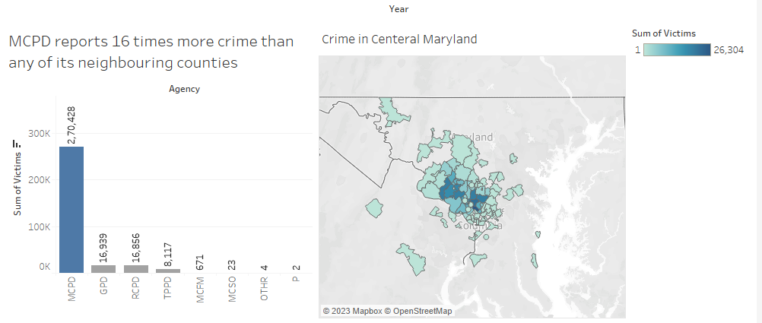

Slide 10
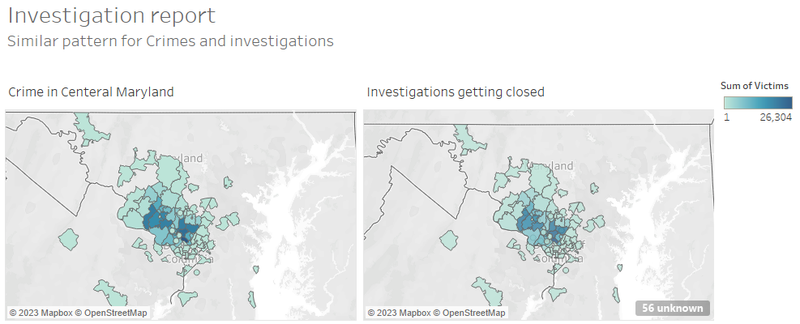
INVESTIGATION REPORT

Slide 11
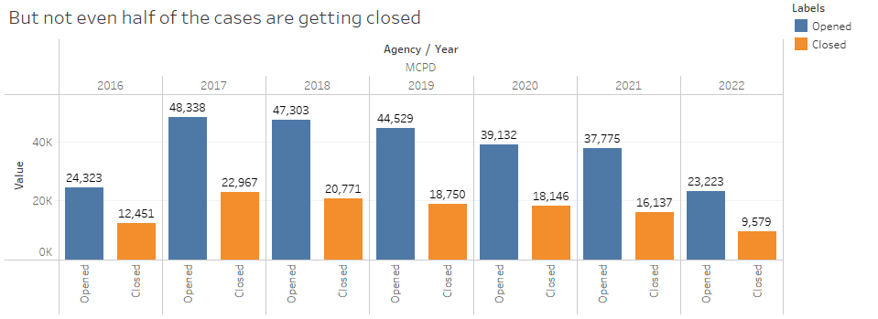

Slide 12
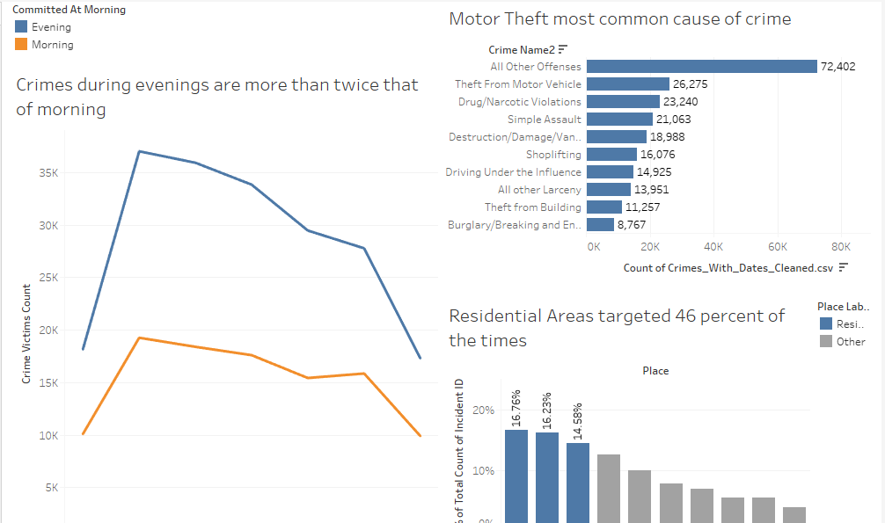
DEMOGRAPHIC DASHBOARD

Slide 13
THANK YOU!!

